Slide 1
HTML5 − WEB FORMS 2.0
HTML forms are required to collect some data from the site visitor.
For example: If a user want to purchase some items on internet, he/she must fill the form such as shipping address and credit/debit card details so that item can be sent to the given address.
An HTML form facilitates the user to enter data that is to be sent to the server for processing. It is a section of a document which contains controls such as text fields, password fields, checkboxes, radio buttons, submit button, menus etc.
Web Forms 2.0 is an extension to the forms features found in HTML4. Form elements and attributes in HTML5 provide a greater degree of semantic mark-up than HTML4 and free us from a great deal of tedious scripting and styling that was required in HTML4.
HTML Form Syntax
<form action="server_url" method="get|post">
//input controls e.g. textfield, textarea, radiobutton, button
</form>

Slide 2
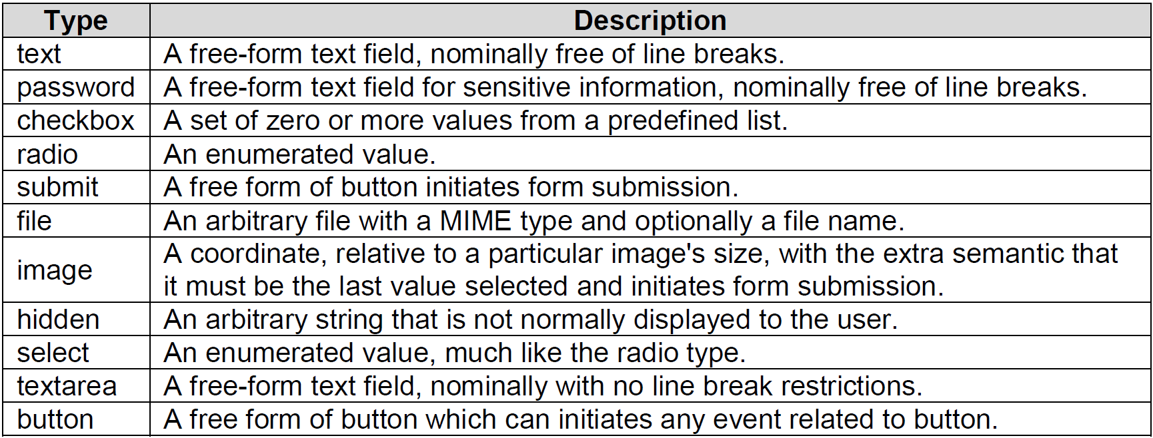
The <input> element in HTML4
HTML4 input elements use the type attribute to specify the data type. HTML4 provides following types −

Slide 3
Following is the simple example of using labels, radio buttons, and submit buttons
<form action=“demo.html" method="post">
<p>
<label for="firstname">first name: </label>
<input type="text" id="firstname"><br />
<label for="lastname">last name: </label>
<input type="text" id="lastname"><br />
<label for="email">email: </label>
<input type="text" id="email"><br> HTML5
<input type="radio" name="sex" value="male"> Male<br>
<input type="radio" name="sex" value="female"> Female<br>
<input type="submit" value="send"> <input type="reset">
</p>
</form>

Slide 4
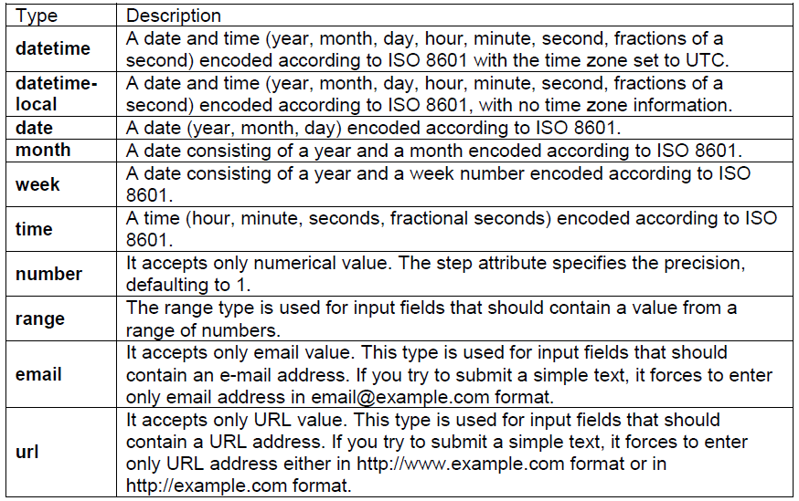
The <input> element in HTML5
Apart from the above-mentioned attributes, HTML5 input elements introduced several new values for the type attribute. These are listed below.

Slide 5
<!DOCTYPE HTML>
<html>
<head>
<script type = "text/javascript">
function showResult() {
x = document.forms["myform"]["newinput"].value;
document.forms["myform"]["result"].value = x;
}
</script>
</head>
<body>
<form action = "/cgi-bin/html5.cgi" method = "get" name = "myform">
Enter a value : <input type = "text" name = "newinput" />
<input type = "button" value = "Result" onclick = "showResult();" />
<output name = "result"></output>
</form>
</body>
</html>

Slide 6
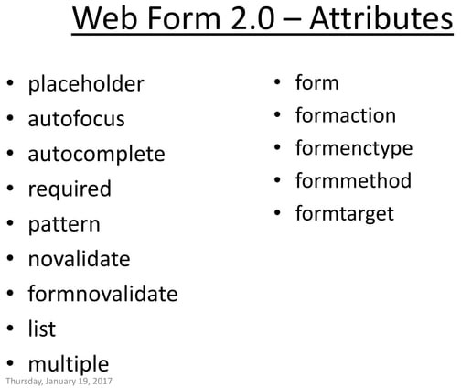

Slide 7
